Slide 1
Advanced Web programming
Lec-12
Web Form Fundamentals

Slide 2
ASP.NET - Custom Controls & User Controls
ASP.NET allows the users to create controls. These user defined controls are categorized into:
User controls
Custom controls
User Controls
User controls behaves like miniature ASP.NET pages or web forms, which could be used by many other pages. These are derived from the System.Web.UI.UserControl class. These controls have the following characteristics:
They have an .ascx extension.
They may not contain any <html>, <body>, or <form> tags.
They have a Control directive instead of a Page directive.

Slide 3
List Controls in ASP.NET
ASP.NET provides the following list controls.
1. Drop-down list
2. List box
3. Radio button list
4. Check box list
5. Bulleted list
These controls display list of options to select. You can select one or more options, the choice depends upon control.
They all derive from the System.Web.UI.WebControls.ListControl class.

Slide 4
Some of the important common properties of list controls are as follows:
SelectedValue: Get the value of the selected item from the dropdown list.
SelectedIndex: Gets the index of the selected item from the dropdown box.
SelectedItem: Gets the text of selected item from the list.
Items: Gets the collection of items from the dropdown list.
DataTextField: Name of the data source field to supply the text of the items. Generally this field came from the datasource.
DataValueField: Name of the data source field to supply the value of the items. This is not visible field to list controls, but you can use it in the code.
DataSourceID: ID of the datasource control to provide data.

Slide 5
There are several ways through which you can populate these controls such as:
By using data from database.
Directly write code to add items.
Add items through the items collection from property window.
Write HTML to populate these controls.
Use inbuilt datasource controls.

Slide 6
1. DropDownList control
DropDownList control is used select single option from multiple listed items.
Select the item from the DropDownList, the label control will display the selected item.
Write code with association with IsPostBack property, otherwise will get the first item of the DropDownList.

Slide 7
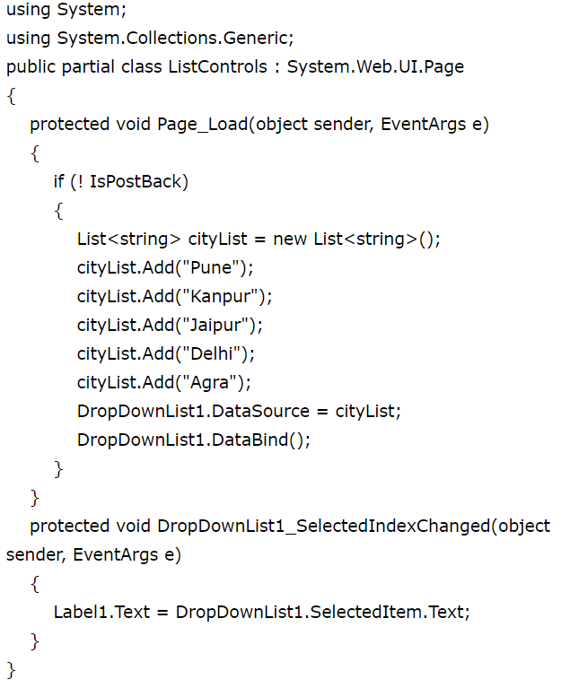

Slide 8
2. ListBox control
The ListBox control is similar to the DropDownList but main difference is that you can select multiple items from ListBox at a time.
ListBox control has SelectionMode property that enables you to select multiple items from ListBox control.
By default SelectionMode property is set as single.
If you want to select multiple items from the ListBox, then set SelectionMode property value as Multiple and press Ctrl or Shift key when clicking more than one list item.
The ListBox control also supports data binding.
You can bind the ListBox through coding with database or attach it with one of the predefined DataSourceControl objects, which contains the items to display in the control.
DataTextField and DataValueField properties are used to bind to the Text and Value field in the data source.
The Add method adds new items at the end of an unsorted list box. The Insert method allows you to specify where to insert the item you are adding.

Slide 9
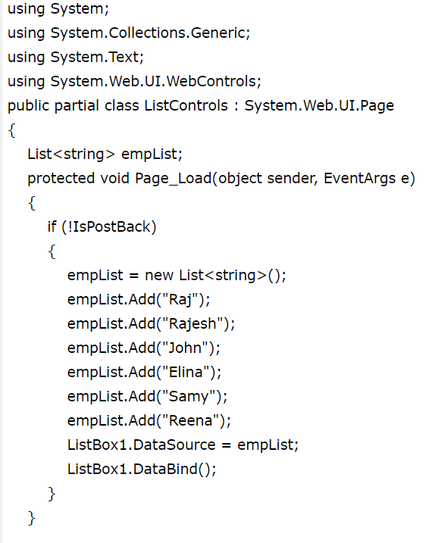
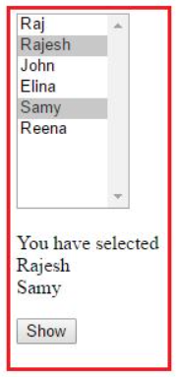
Click on show button, you will get the selected items.
The ListBox control has a SelectedIndexChanged event handler.
If AutoPostBack property is set to true, then this event is raised whenever you select new item from the List control.

Slide 10
3. RadioButtonList Control
RadioButtonList Control is same as DropDownList but it displays a list of radio buttons that can be arranged either horizontally or vertically.
You can select only one item from the given RadioButtonList of options.
The RadioButtonList control supports three important properties that affect its layout: RepeatColumns: It displays the number of columns of radio buttons. RepeatDirection: The direction that the radio buttons repeat. By default RepeatDirection value is vertical. Possible values are Horizontal and Vertical. RepeatLayout: Determines whether the radio buttons display in an HTML table.
Possible values are as follows: Table
Flow
OrderedList
UnorderedList

Slide 11
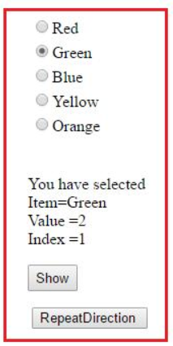


You can add items in RadioButtonList through item collection using property window.
When you click on the RepeatDirection button the layout will be changed as Horizontal.
RadioButtonList1.RepeatDirection = RepeatDirection.Horizontal;
By default RepeatColumns value is zero. You can change this value according to
application need.
If you set this value as three then output will be changed as:

Slide 12
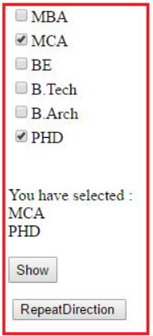

4. CheckBoxList Control
CheckBoxList is generally used, when you want to select one or more options from given several choices.
Most of the properties are same as RadioButtonList control, but the main difference is that you can select more than one item from CheckBoxList control.
The CheckBoxList control is easier for use, when you have set of options of checkboxes.
When you click on the RepeatDirection button the layout will be changed as Horizontal.
By default, RepeatDirection is set to RepeatDirection.Vertical.

Slide 13
5. BulletedList Control
BulletedList control is very rich in displaying the items in different styles.
It dispalys the list either in unordered or ordered list. Each list item can be rendered as plain text, a LinkButton control, or a link to another web page.
BulletedList control supports the BulletStyle property.
The default value of BulletStyle property is NotSet and rendered as in list of bulleted items.
BulletedList control also supports the DisplayMode property that is used to modify the appearance of list items.
Possible values are as follows:
HyperLink
LinkButton
Text

Slide 14
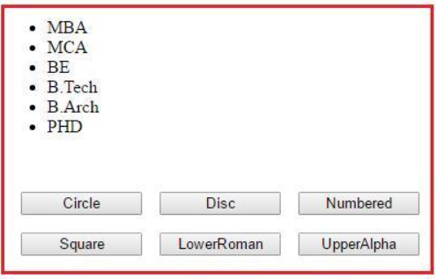
When you click on different button, the button style of list control will be changed accordingly.
In this example we have used Command Button concept.

Slide 15
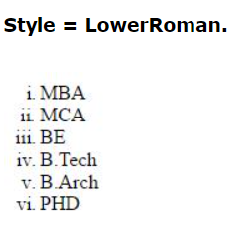
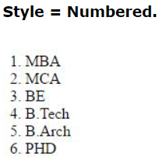
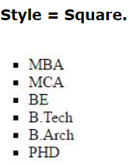

Slide 16
Rich Controls
These are controls whose object model is largely separate from the HTML they generate.
Rich controls are still handled as single objects, they only differ from normal controls in terms of more complex HTML and user interface being generated.
ASP.NET provides large set of controls. These controls are divided into different categories, depends upon their functionalities. The followings control comes under the rich controls category.
1. FileUpload control
2. AdRotator control
3. Calendar control
4.MultiView control
5.Wizard control

Slide 17
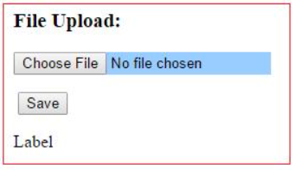
1. Fileupload Control
FileUpload control is used to browse and upload files.
After the file is uploaded, you can store the file on any drive or database.
FileUpload control is the combination of a browse button and a text box for entering the filename.

Slide 18
The FileUpload control supports the following important properties. FileBytes: It returns the contents of uploaded file as a byte array
FileContent: You can get the uploaded file contents as a stream.
FileName: Provides the name of uploaded file.
HasFile: It is a Boolean property that checks whether particular file is available or not.
PostedFile: Gets the uploaded file wrapped in the HttpPostedFile object.

Slide 19
The FileUpload is declared like this:
<asp:FileUpload ID="MyUpload" runat="server" />
“<input type=”file”>” is the HTML tag.
Allowing multiple files to be uploaded at once by using the AllowMultiple property.
<asp:FileUpload ID="MyUpload" AllowMultiple="true" runat="server" />
Uploading Large Files
Modifying the uploaded file size limit: by default this limit is set to 4MB.
If you want to upload a file more than four megabytes of data, you need to change this setting.
This functionality can be altered through the config file by specifying a value for the maxRequestLength setting in the httpRuntime tag.

Slide 20
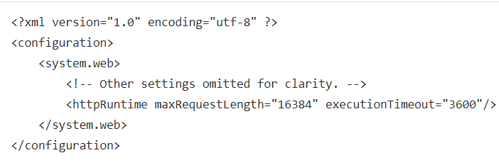
In the following example files up to 16384 bytes (16MB) are allowed:
executionTimeout is commonly used alongside maxRequestLength and it restricts the time in seconds for a file request to be executed.
While extremely useful in some scenarios, maxRequestLength shouldn’t be used when not needed because abnormally large files can temporarily block the ASP .NET threads and even be part of Denial of Service (DoS) attacks.

Slide 21

AdRotator
AdRotator is mainly used to switch through randomly selected images previously collected in a group.
Most users have seen the AdRotator in action when they open a page containing banner ads.
AdRotator’s are easily implementable on ASP .NET pages and even more, the predefined images can be stored separately inside the config file.
The list of images must be stored in XML format. This is an example of two images stored for the AdRotator:
<asp:AdRotator id="Ad" runat="server" AdvertisementFile="MyAdRotator.xml" Target="_blank" KeywordFilter="Test" />
https://www.youtube.com/watch?v=UBVmw2mTYzM

Slide 22
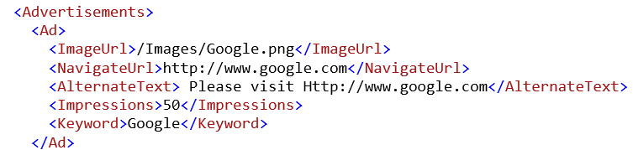
The AdRotator control can be modified through several properties. They are the following:
ImageUrl
NavigateUrl – link to open when clicked on the banner
AlternateText – the alt attribute of the banner image
Impressions – determines how often the banner will appear.
Keyword – used for filtering. For example, developers can restrict banners with certain keywords from appearing on the page

Slide 23
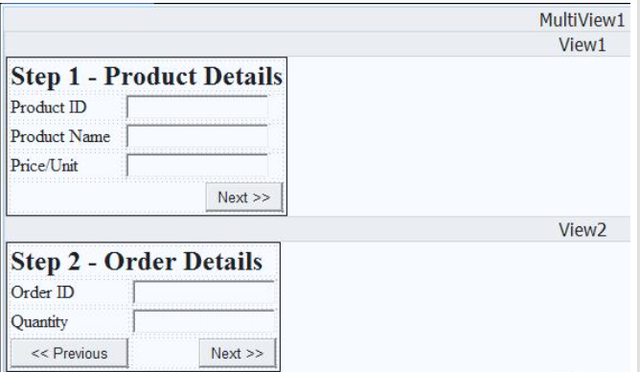
MultiView control
MultiView control can be used when you want to create a tabbed page.
In many situations, a web form may be very long, and then you can divide a long form into multiple sub forms. MultiView control is made up of multiple view controls. You can put multiple ASP.NET controls inside view controls.
One View control is displayed at a time and it is called as the active view. View control does not work separately. It is always used with a Multiview control.

Slide 24
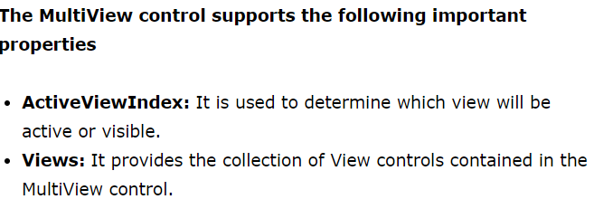
Multiview Control
https://www.youtube.com/watch?v=FxOIEKpHchg

Slide 25
Wizard Control
This control is same as MultiView control but the main difference is that, it has inbuilt navigation buttons.
The wizard control enables you to design a long form in such a way that you can work in multiple sub form. You can perform the task in a step by step process. It reduces the work of developers to design multiple forms. It enables you to create multi step user interface. Wizard control provides with built-in previous/next functionality.
Important events of Wizard control are as follows:
ActiveStepChanged:
CancelButtonClick:
FinishButtonClick:
NextButtonClick:
PreviousButtonClick:

Slide 26
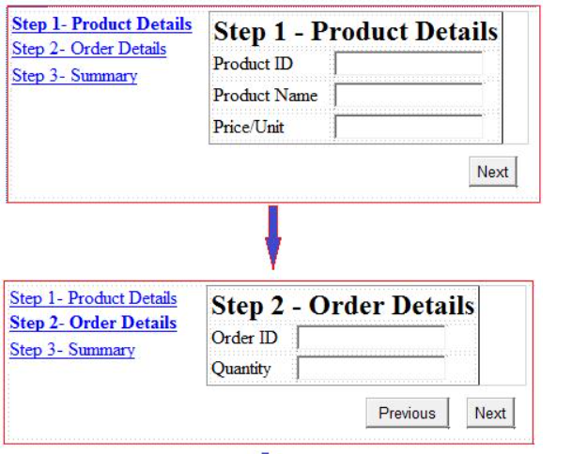

Slide 27
The StepType associated with each WizardStep determines the type of navigation buttons that will be displayed for that step.
The StepTypes are:
Start:
Step:
Finish:
Complete:
Auto:
Wizard is the more complex version of MultiView.
It can (and will do by default) show a sidebar with navigation through different steps in a task thus providing the option for the user to skip certain task steps.

